Slide 1
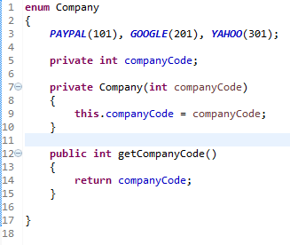
Java Enum
We can not create instance of enums by using new operator in Java because constructor of Enum in Java can only be private and Enums constants can only be created inside Enums itself.
Instance of Enum in Java is created when any Enum constants are first called or referenced in code.
Enums can contain constructors, methods, variables, and constant class bodies.
enum constants can send arguments to the enum constructor, using the syntax BIG(8), where the int literal 8 is passed to the enum constructor.
enum constructors can have arguments, and can be overloaded.
enum constructors can NEVER be invoked directly in code. They are always called automatically when an enum is initialized.

